Slide 1
Minor on security
Protect: Cryptography (Lecture 5- ICT)
Leo van Koppen MSIT

Slide 2
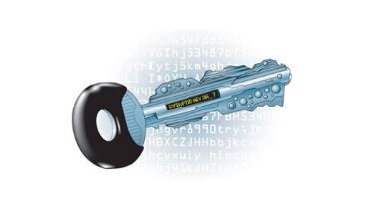
Agenda
Introduction crypto
Symmetric crypto
Asymmetric or public key crypto RSA (math)
Hashing/ digital signatures
Hybrid systems
Trusted third party (TTP)
PKI + certificates
Secure Socket Layer (SSL)
General guideline in encryption:
No security by obscurity

Slide 3
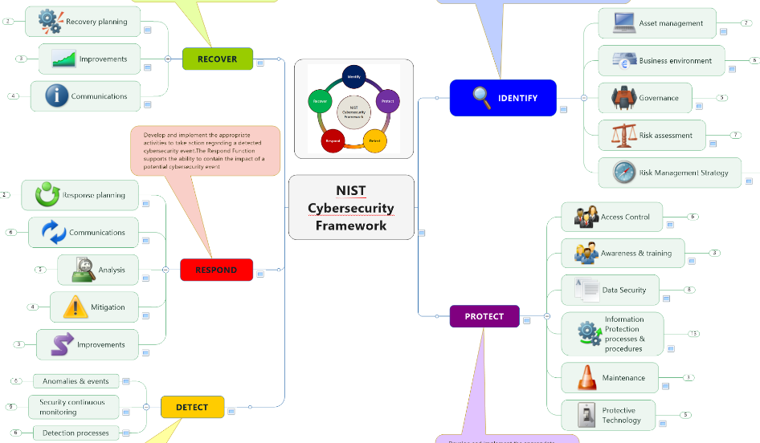
Protect: data security = cryptography & access control
Tomorrow L6
Today L5

Slide 4
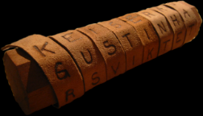
Protection of confidentiality
NEED: Assurance of confidentiality
but how?
Very old issue, “as old as the road to Rome”
In that period a scytale (below) was used?
Key is de diameter of the stick
Another crypto method was Caesar algorithm ..
Transposition; key is number of postions
In general, use a way of coding
Keep your key secret
Or a shared secret
Cryptography = encoding/decoding
Crypto analysis = analysing and cracking of a key or algorithm

Slide 5
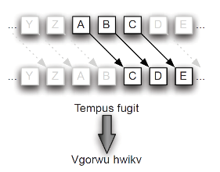
Caesar-substitution
This is a form of mono-alphabetic substitution
Constant shift in position in the alphabet (e.g. 5 positions)
Example:
M = A T T A C K A T E I G H T O' C L O C K
C = D W W D F N D W H L J K W R' F O R F N
??positions?
Key = 3
Crypto analysis is rather easy!
25 different keys
after 25 tries (all possibilities) you will see the clear tekst
This is what we call a “brute force attack”
Key = 2

Slide 6
Cryptography
Cryptography is a (the) measure to guarantee secrecy of information in a computer system (exclusivity of information)
In storage or transport
The objective is create:
Confidentiality
Also applied in
Integrity and authenticity
Applied in complex systems
Certificates (PKI)
Storage: disk, document, “keys” on a smartcard
Transport: Connections (SSL/TLS, VPN)
Enormous number of users

Slide 7
Crypto “language” Hierarchy in crypto measures
Level of application
Confidentiality
Integrity
Non repudiation
Authentication (access control)
Encryption
Digital signature
Symmetric algorithm
Asymmetric algorithm
Hashing algorithm
Crypto security delivers a service e.g Confidentiality
That uses a mechanism encryption
That is based on the primitive (or type): asymmetric algorithm
That is based on RSA

Slide 8
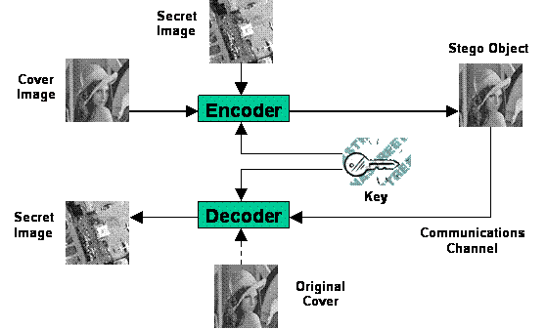
History of cryptography
Very old!
Egypt, China, Romains
Art of war, lovers, secret messages
Different ways of cryptography
Steganography = hiding information in other objects like
scratches in wood covered with wax, on bolded head of a messenger
letters in a book "invisible“ marked
Digital hiding in a multimedia file
wherein the carrier (file) does not increase in size

Slide 9
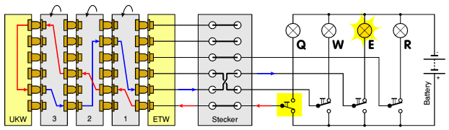
Famous code system:
What is it?
Used by Nazi regime in 2nd World war
Poly alphabetic substitution
Cracked by British Secret Service (Bletchley Park)
Some nice videos of Enigma
http://nl.youtube.com/watch?v=HwNGF6te_6A
https://www.youtube.com/watch?hl=nl&gl=NL&v=hiOjqskDlS0#t=35.485481

Slide 10
More serious encryption systems
2 types
Symmetric algorithm
Encoding scheme in which only one key is used
Sender and receiver got the same key
Possible problems:
How do you get the secret key (in a safe way) at the other party?
What if the key is stolen and disclosed?
Asymmetric algorithm
Two keys
One public key --- for encryption
One private key --- for decryption
Known als public key encryption or RSA

Slide 11
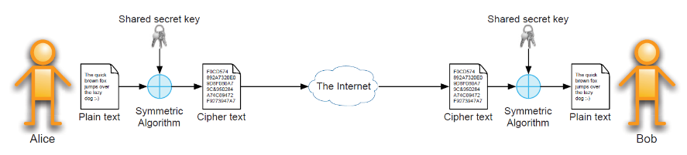
Symmetric cryptographic systems (1)
DES (Digital Encryption Standard) → triple DES
Blocks of 64 bits,Key of 64 bits (effectief 56 bits)
Weak, not accepted anymore, Triple DES (3DES) is still in use
AES (Advanced Encryption Standard)
Blocks of 128, 192 or 256 bits (your choice)
Keys of 128, 192 of 256 bits (your choice)
USA standard since 2001, successor of DES algorithm

Slide 12
Abstraction
C = E_{K}(M) M = E_{K}(C) ➔ M= E_{K}(E_{K}(M))
E encryption
D decryption
P plain text
M message
C ciphertext
K key

Slide 13
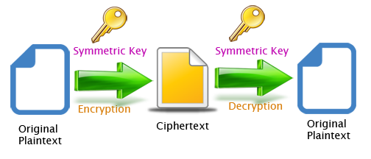
Generic model
Algorithm is public available
Built-in software
Built-in chip
Symmetric key K
Key length = strength → longer = stronger = work factor for crypto analist
Divided into several different keys
NOT public available

Slide 14
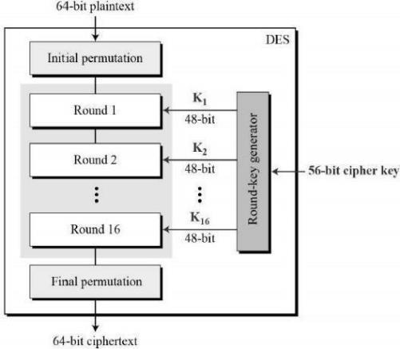
Data Encryption Standard DES (2)
Standard since 1977 (IBM)
Permutations and substitutions
(combination = product cryptography)
Permutations:
Crossing bits
Substitutions:
Replacing bits by others
(will be showed in AES)
Block encryption
(64 bits per block)
Key is 64 bits,
of which 56 effective
(8 control bits)

Slide 15
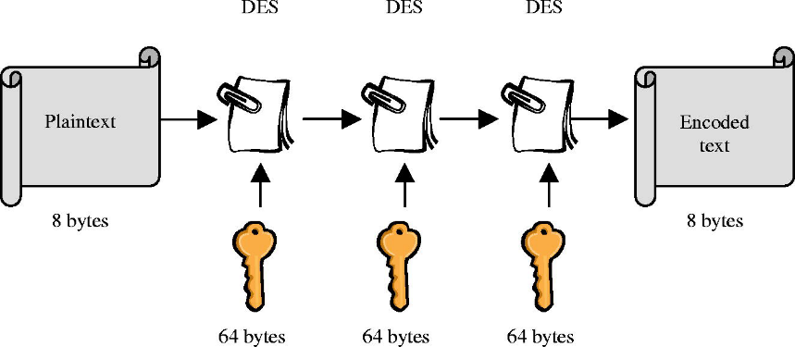
Data Encryption Standard DES (4)
DES wasn’t strong enough!
Triple-DES (3DES)
3 x DES, 3 different keys

Slide 16

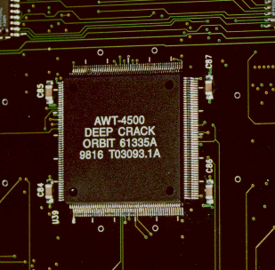
Trust in DES encryption!
Crypto analysis on DES
brute force (key length van 56 bits)
Competition (prize $10.000)
Cracked in 1997
39 dagen
Network of computers
Cracked in 1998
3 days
Crypto analysis in hardware (LCA)
Cracked in 1999
22 hours and 15 min
Network van computers
No trust in DES anymore

Slide 17
Advanced Encryption Standard AES
Follow up of DES
Symmetric system
Bigger key length possible
Better design principles (more transparent)
Winner of the NIST competition National Institute for Standardization and Technology
sept. 1999 competitors
MARS IBM
RC6 RSA
Twofish Counterpane (Bruce Schneier)
Serpent researchers from UK, Denmark and Israel
RIJNDAEL 2 Flemish researchers (Rijmen en Daemen)

Slide 18
Advanced Encryption Standard AES (2)
RIJNDAEL in 2001 standard by NIST as AES standard
Characteristics of AES
Different key length 128, 192 of 256 bits
Based on 3 elementary operations
efficient to implement in SW and HW
Variety in types of hardware (embedded sytems)
Used in chip or smart cards
Broad range of applications
How it works !
https://www.youtube.com/watch?v=mlzxpkdXP58
flash demo on BB

Slide 19
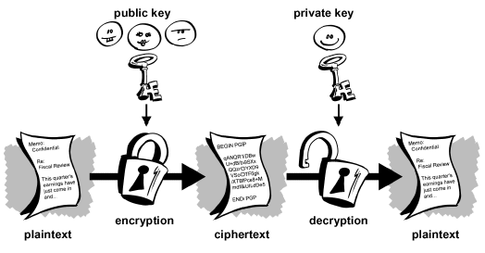
Asymmetric encryption
Alice has a public key P_{B} of Bob
Alice encrypt Message M as C= E_{PB}(M)
Bob got its own private private key S_{B}
Bob decrypt cipher text C : D_{SB}(C) results in M
Because: D_{SB}( E_{PB}(M) ) = M

Slide 20
Asymmetric cryptographic systems
(Public key encryption)
Source and destination use different keys
Different algorithms (all asymmetric)
RSA (Rivest, Shamir en Adleman) (well known)
- Encryption and digital signature
El Gamal
- Encryption and digital signature
Diffie-Hellman (1977)
- Distribution of a secret key
DSA (Digital Signature Algorithm) of DSS
- Digital signature
Based on new mathematic algorithm of eliptic curves
ECC (Elliptic Curve Cryptography)

Slide 21
Abstraction asymmetric encryption
RSA-systeem
developed at MIT by Rivest, Shamir en Adleman (1978)
2 keys, together one pair
Public key: available for everyone
Private key: keep it that way, PRIVATE!

Slide 22
Encryption in a RSA-system
Encryption
Divide message into blocks
Calculation for every block (M)
Involution to the power e
Calculate modulo n
C = M_{x}^{e} (mod n)
Decryption:
Calculation of every block (C):
Involution to the power d
Calculate modulo n
Compose message from different blocks
M – C_{x}^{d} (mod n)

Slide 23
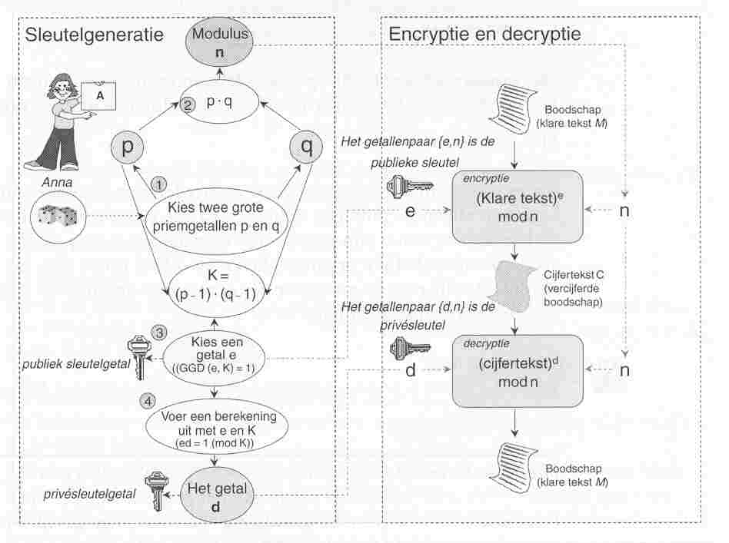
RSA algorithm (in dutch ☹)

Slide 24
Het RSA systeem
encryption: C = P^{e} mod n ➔ public key is: { n, e }
decryption: P = C^{d} mod n ➔ private key is: { n, d }
Calculation done (math)
n = p * q en K = (p-1) * (q-1);
p en q are primes
Calculate e; GCD (e,K)=1
(e < K no common factor with K)
Calculate number d from
(e * d) mod K = 1
example
Assume: p = 3 en q = 11 so:
n = p*q = 33 and K = (p-1)*(q-1)
K= (3-1)*(11-1) = 20
Choose e ; GCD (e, K)=k
➔ e = 3,
Calculate number d
(3*d) mod 20=1
➔ d = 7

Slide 25
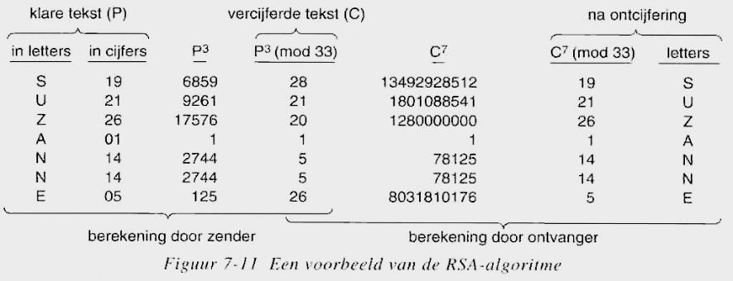
RSA example
Assume: e = 3, d = 7
Encryption : C = P^{e} (mod n) ➔C = P³ (mod 33)
Decryption : P = C^{d} (mod n) ➔ P = C⁷ (mod 33)
Example:

Slide 26
Modulo calculations
Which day is it in 8 days?
Today + 1 modulo 7!
Which day is it in 13 modulo 7 days?
Which day is it in 749 modulo 7 days?
Which month is it in 35 modulo 12 months
Today +1
Today + 6
Today + 0 = Today!
October + 11= September

Slide 27
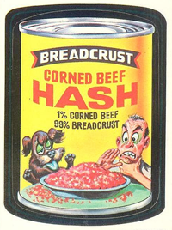
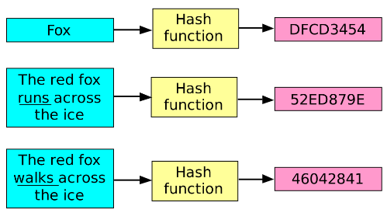
Hashing
Crunching data to a unique code
With a fixed length
One way!
https://brilliant.org/wiki/secure-hashing-algorithms/
Different algorithms
MD2, MD4, MD5 (128 bits Ron Rivest, MIT)
SHA-1,SHA-2 (160 bits, US standaard)
& Digital signatures

Slide 28
Hashing: one way functions (“reverse” encryption)
How it works:
a function, this way f(x) = …. is easy to calculate
example:
f(x) = x³ ➔ involution third power; rather easy!
The other way around is to complex
example:
f⁻¹(x) = ³√x very hard to handle
f⁻¹(x) = Ek(M) ➔ calculate message M from encrypted message C= Ek(M)

Slide 29
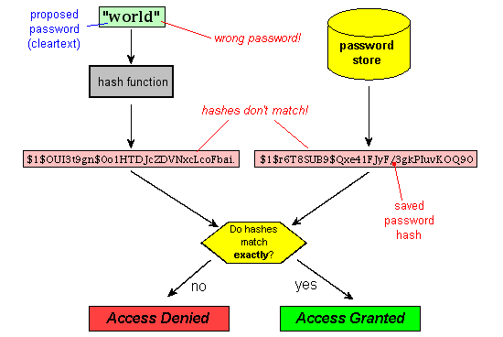
Hash function: applied
http://www.unixwiz.net/techtips/iguide-crypto-hashes.html
Storage of passwords

Slide 30
Calculation of hashfunction of message (M)
h = H(M)
M = message (random length)
H = hash function or message digest function
h = hash value or message digest (MD)
Hash value (fixed length, b.v. 128 bits)
Hash function H
given a message M
calculation of hash value is H(M) rather easy
H is an one way function
H(M) is “collision free”, that means
It is impossible to calculate or find the original message M’
in such a way that h = H(M’)

Slide 31
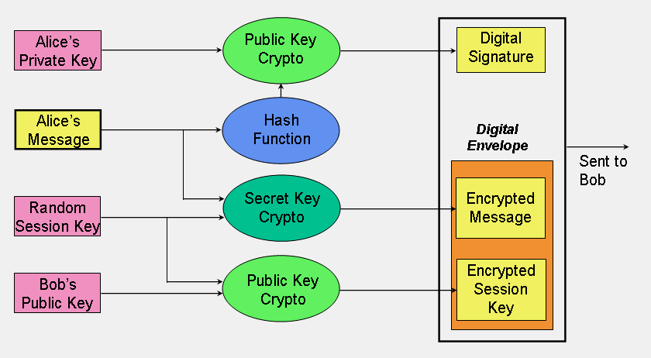
Digital signature is a electronic signature based on cryptography
Digital signature delivers assurance about identity of the sender
assurance about identity = authenticity
Requirements for a digital signature:
Not forgeable
Not reusable
Not changeable
Not to deny

Slide 32
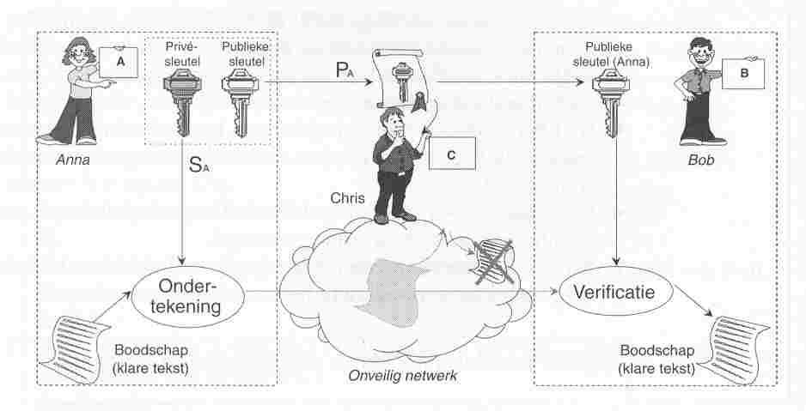
Digital signature (2)
How to apply?
Alice uses her private key S_{A} to sign her message
Alice sends the signed message to Bob
Bob verifies the identity of Anna with Anna’s public key
Bob over de afzender van het bericht
Private key of Alice
Public key of Alice
Public key of Alice
Alice
Bob
Signing
verification
Clear tekst
Clear tekst

Slide 33
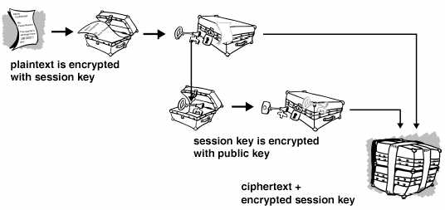
Hybrid systems Combination of symmetric & asymmetric
Encryption with public key (asymmetric) and private or session key (symmetric)
So-called suitcase model

Slide 34
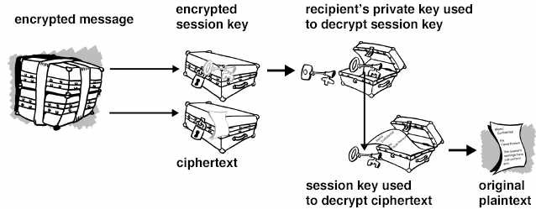
Combination symmetric and asymmetric
Decryption with private key of the session key
Decryption of message with session key

Slide 35
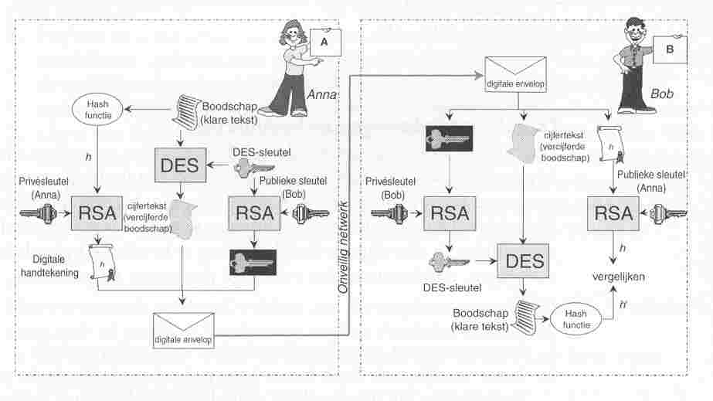
Hybrid system
All combined in one picture

Slide 36
Description
Anna
computes hash value h of message M
encrypts H with its private key
generates a secret session key
encrypts the message with the session key
encrypts the session key with the public key of Bob
sends the encrypted message along with the encrypted session key and, together with the encrypted hash value to Bob
Bob
decrypts the session key aid of its private key
decrypts the encrypted message aid of the session key
calculates a hash value h 'from the received message
decrypts the received encrypted hash value with the public key of Anna
compares the two hash values ​​h and h 'if equal, then the signature is correct and thus the identity of Anna is guaranteed and the message is not altered on the move

Slide 37
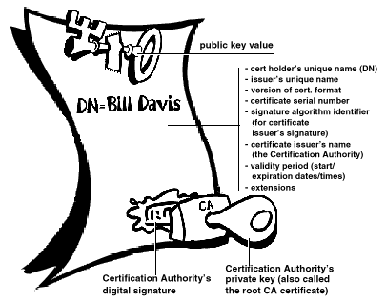
Problem: can you trust a public key?
How can Alice be sure that this public key belongs to Bob?
A public key is (public) available at key servers
But belongs this key to the that person?
How to prove?
PKI-system
Certification Authority CA
Issues certificates with public keys
Registration Authority RA
Registration of users
Trusted third party TTP

Slide 38
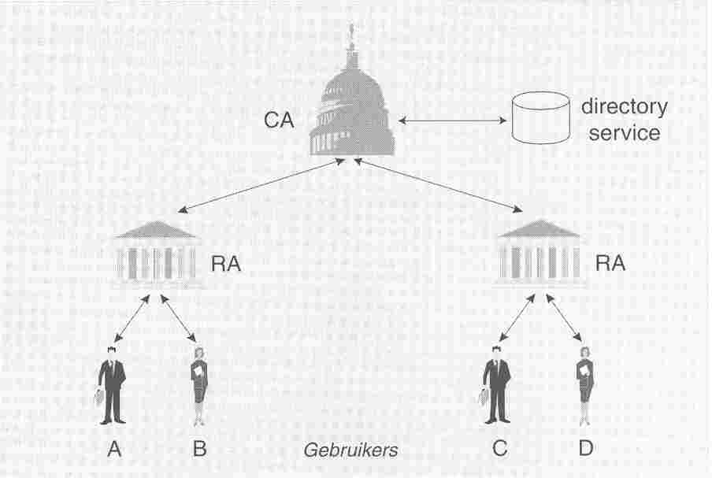
Public Key Infrastructure PKI (2)
PKI consists of
CA certification authority
RA registration authority
+ directory service

Slide 39
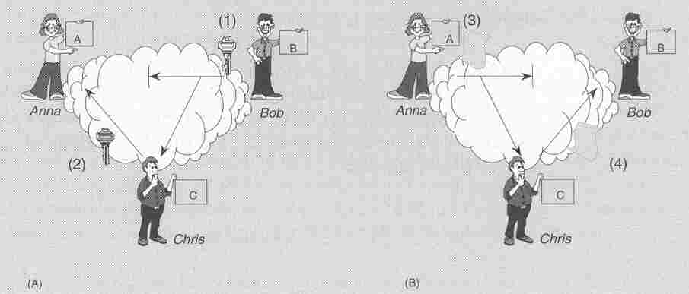
Problem: can you trust a public key?
Guaranteed relationship between identity and teh owner of the key
is this really the public key of Bob?

Slide 40
De Public Key Infrastructure PKI
uses public-key cryptography
guarantees the link between the identity of user and his public key (or organization)
gives a digital certificate from (is a type of ID card)
manages the digital certificates (issuance and revocation)
minimum information on a certificate:
owner name / public key of the owner
expiration date of the certificate
name van of issuer of the certificate
Serial number
digitale signing of issuer
X.509 is a standard for PKI

Slide 41
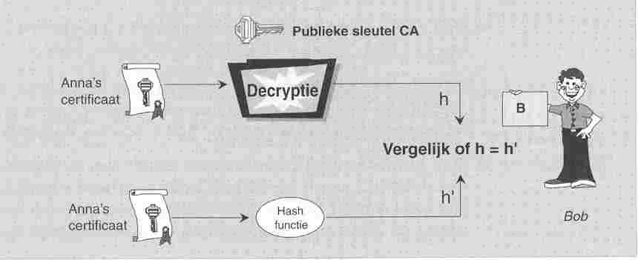
Trusted Third Party (2)
Checking the authenticity of a certificate:

Slide 42
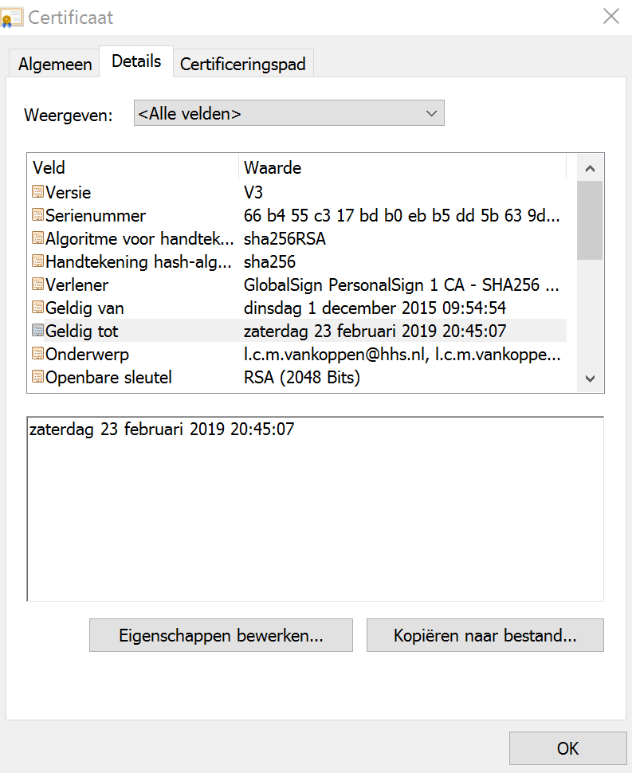
X509
X509 Certificates are in your browser
Check it!
Which one did you found?

Slide 43
Public Key Infrastructure (3)
Certification Authority CA
Registration Authority RA
Directory services
----
users requests certificates through the directory service,
usually in X.509 format
a method is mentioned in:
Certificate Practice Statement (CPS)
list of blocked or revoked certificates
Certificate Revocation List (CRL)
Trusted Third Party (TTP)

Slide 44
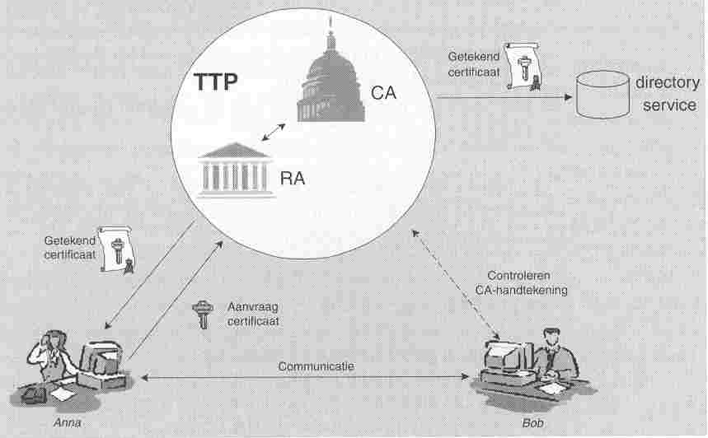
Trusted Third Party
application and use of a certificate:

Slide 45
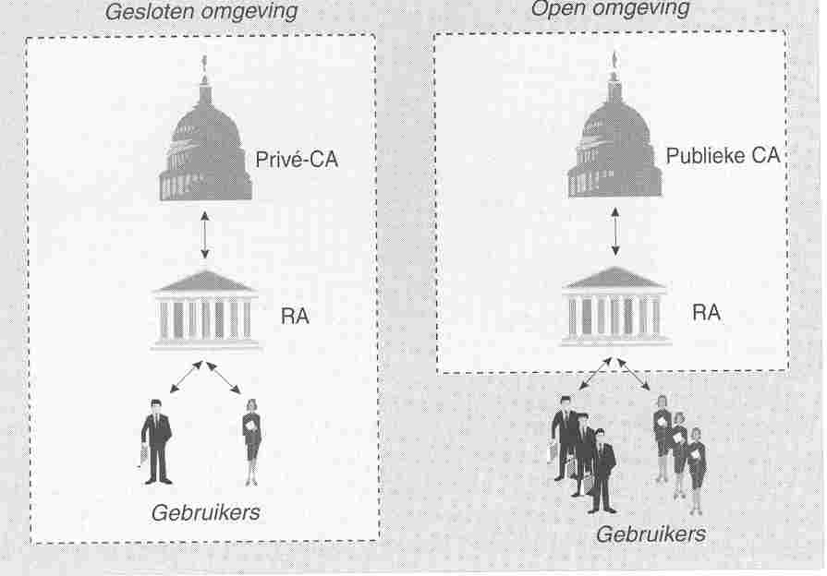
Types of PKI
Area closed / open environment
Organization example HHS / open organization IETF

Slide 46
Sessie encryption takes place at the transport layer
Application layer bytestream
PGP, S/MIME XML signature, certificates
Transport layer
segments with encrypted data SSL (Secure Socket Layer) TLS (Transport Layer Security) protocol
Network layer IP packets encrypted data IPsec en ESP VPN (Virtual Private Network) in tunnel mode
Datalink layer frames with encrypted data or whole frame encrypted

Slide 47
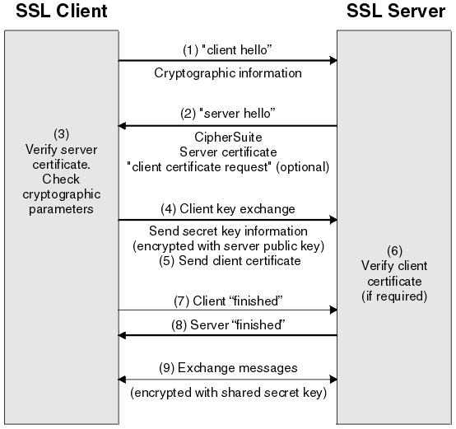
SSL/TLS-protocol

Slide 48
SSL Secure Sockets Layer
extra layer between the application layer and the transport layer
no modifications to existing software
Protection information exchange between browser and web server
Encryption of data
digital signing
serverauthenticatie en clientauthenticatie
werkt met certificaten
SSL v1 en SSL v2 vertonen gaten, SSL v3 is veilig
SSL v3 gestandaardiseerd door IETF evenals TLS

Slide 49
SSL Secure Sockets Layer, werking
1) Anna's browser says:
SSL version number
available symmetric algorithms
key length asymmetric keys
and some other information
2) Server sends:
similar data
It’s digital certificate
3) Anna's browser verifies the data transmitted
server certificate is valid, the date has not expired?
Is the CA server certificate signed or a trusted CA for the browser?
verification of digital signature on a server certificate with public key of the CA certificate as at CA State
correct domain name server domain name server certificate?

Slide 50
Leo van Koppen MSIT
l.c.m.vankoppen@hhs.nl

